Slide 1
To analyse vertical circular motion
Success Criteria
I can calculate velocity, acceleration and force for:
  Vertical circular motion

Slide 2


To analyse circular motion
Do Now
A person is travelling in a rollercoaster cart at a velocity of 4 ms⁻¹ to the right. If the person is 50 kg, calculate the forces acting on the person.

Slide 3
To analyse circular motion
Do Now
A person (still with mass of 50kg) is travelling at 8 ms⁻¹ through a dip of radius 2.5m. Calculate the forces acting on the person.
2.5m
Notes:
Accelerating to the centre
Fnet = ma = 50 * 26 = 1300 N upwards
Normal force is how you experience your own weight so you’ll feel heavier

Slide 4
To analyse circular motion
Do Now
A person (still with mass of 50kg) is travelling at 2 ms⁻¹ travels over a rise of radius 2.5m. Calculate the forces acting on the person.
2.5m
Notes:
Accelerating to the centre
Fnet = ma = 50 * 1.6 = 80 N upwards
Fn = 410 N up
Normal force is how you experience your own weight so you’ll feel lighter (lower normal force)

Slide 5
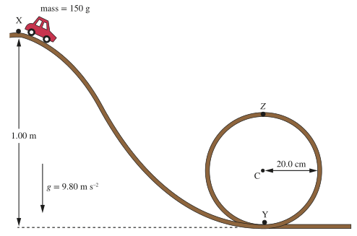
To analyse vertical circular motion
Energy Balance
Energy balances can be an easy and effective way to analyse vertical circular motion.
Key assumption for this to be accurate?
No energy loss
Notes:
Class exercise: describe PE and KE at each point on the circle
Class exercise: calculate PE, KE, total mechanical energy, normal reaction force and velocity at X, Y and Z
X: PE = 1.47J, KE = 0J, ME = 1.47J, v = 0, Fn = 1.47N
Y: PE = 0J, ME = 1.47J, KE = 1.47J, v = 4.43m/s, Fn = 16.2N up
Z = PE = 0.588J, ME = 1.47J, v = 3.43m/s, Fn = 7.35N down

Slide 6
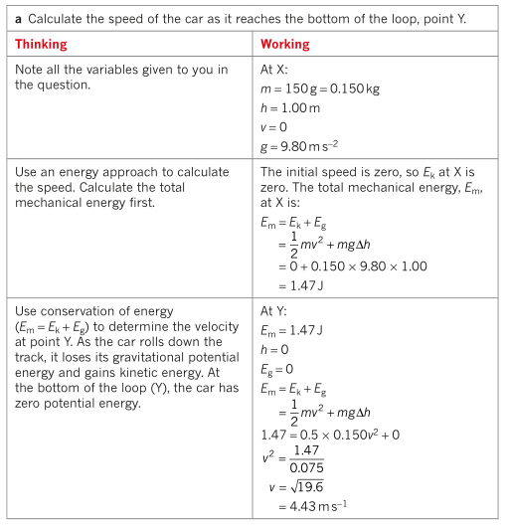
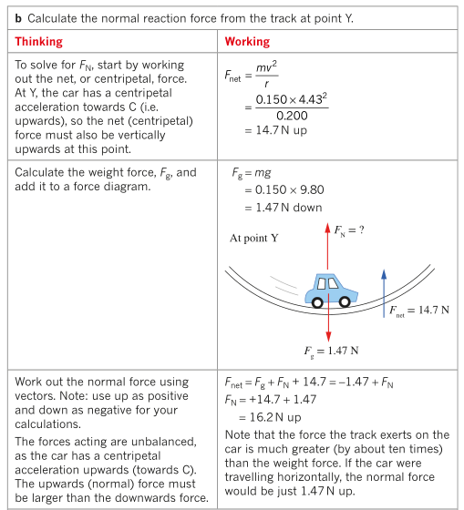
To analyse vertical circular motion
Energy Balance
Notes:
Class exercise: describe PE and KE at each point on the circle
Class exercise: calculate PE, KE, total mechanical energy and velocity at X, Y and Z
X:

Slide 7
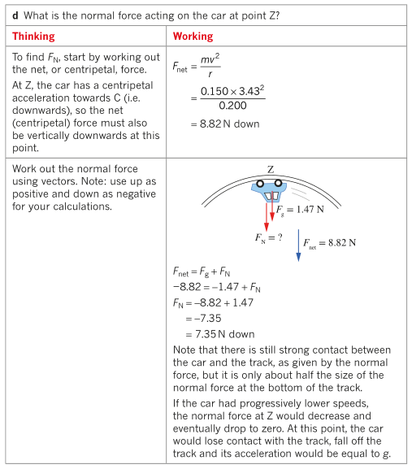
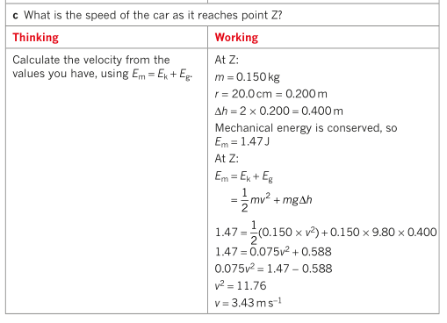
To analyse vertical circular motion
Energy Balance
Notes:
Class exercise: describe PE and KE at each point on the circle
Class exercise: calculate PE, KE, total mechanical energy and velocity at X, Y and Z
X:

Slide 8
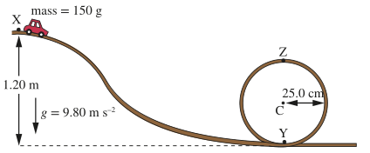
To analyse vertical circular motion
Energy Balance: Your Turn
Calculate:
Speed at Y
Normal reaction force at Y
Speed at Z
Normal reaction force at Z
Notes:
X: PE = 1.76J, KE = 0J, ME = 1.76J, v = 0
Y: PE = 0J, ME = 1.76J, KE = 1.76J, v = 4.85m/s, Fn = 15.6N up
Z = PE = 0.735J, ME = 1.76J, v = 3.70m/s, Fn = 8.21N down

Slide 9
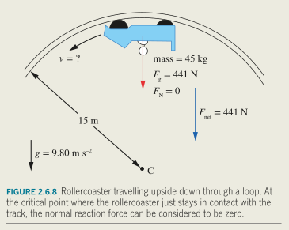
To analyse vertical circular motion
Minimum speed inside a loop
Notes:
Fnet = Fg + Fn Fn = 0
Fnet = Fg
mv^2/r = mg
v = sqrt(gr)
For this exercise: r=15 therefore v = 12 m/s = 43 km/h
Note that you don’t need know mass

Slide 10
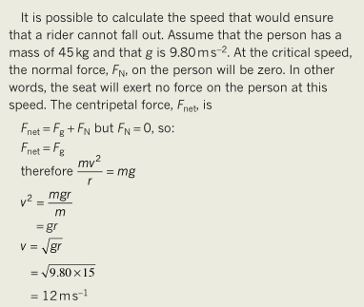
To analyse vertical circular motion
Minimum speed inside a loop
Notes:
Fnet = Fg + Fn Fn = 0
Fnet = Fg
mv^2/r = mg
v = sqrt(gr)
For this exercise: r=15 therefore v = 12 m/s = 43 km/h
Note that you don’t need know mass

Slide 11
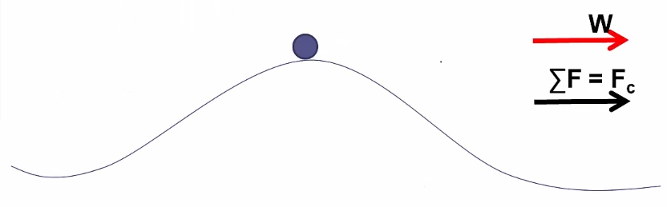
To analyse vertical circular motion
Minimum speed on top of a loop
Normal force must be less than the weight force otherwise net force doesn’t point towards centre of circle.
F_{c} = F_{g} – F_{n}
F_{n} = F_{g} – F_{c} = mg – mv²/r
If the weight force is smaller than the centripetal force then the object will fly off the circular path.
Another way of saying this:
A negative normal force is not possible and indicates that the object is not in contact with the track (it isn’t real).
If weight force is less than required centripetal force, the object cannot move in a circle.
F_{n}
F_{c}
F_{g}
Notes:
Normal force must be less than the weight force otherwise net force doesn’t point towards centre of circle

Slide 12
To analyse vertical circular motion
Minimum speed on top of a loop
John is at the highest position of a 30.0m wide ferris wheel (note: ferris wheels have a constant speed, unlike rollercoasters). It took 60.0s to reach this position after he entered at the base of the ride. John has a mass of 70.0kg. Calculate the normal reaction force of the seat acting on John.
Watch your force directions.
Assign a direction convention (what is +ve)
F_{n}
F_{c}
F_{g}
Notes:
v = 2*pi*r/T = 2*pi*15/120 = 0.7854 m/s
Fc = W – N
N = W – Fc
= mg – mv^2/r
= 70*9.8 – 70*0.7854^2 / 15 = 683 N
Note: reaction force is only three N off of John’s weight force (because velocity is very small).

Slide 13
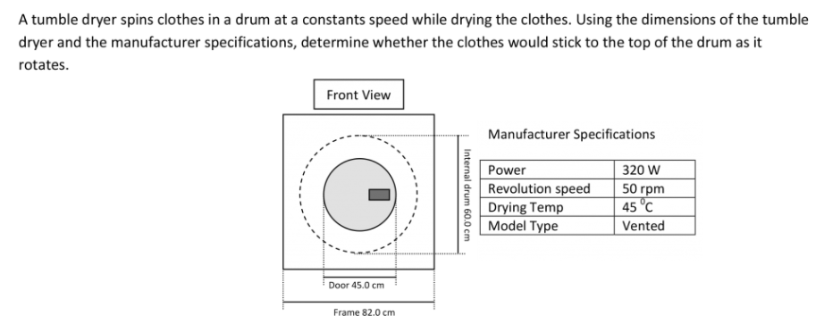
To analyse vertical circular motion
Practice

Slide 14
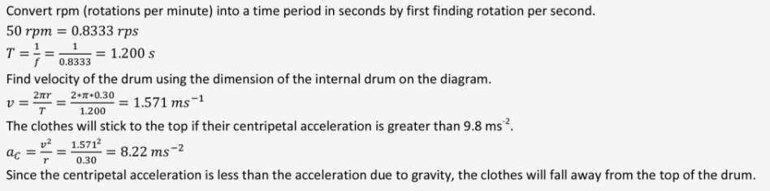
To analyse vertical circular motion
Practice
Another way:
Minimum velocity to complete circular motion.
Fg = Fc (Fn = 0)
mg = mv^2/r
v = sqrt(gr) = sqrt(9.8*0.3) = 1.715 m/s
Actual velocity is lower than the minimum, therefore clothes will fall away from top of the drum.

Slide 15
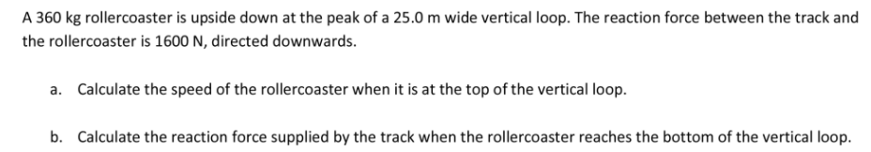
To analyse vertical circular motion
Practice

Slide 16
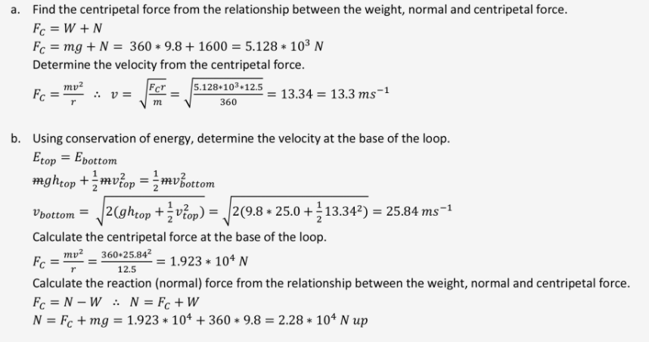
To analyse vertical circular motion
Practice

Slide 17
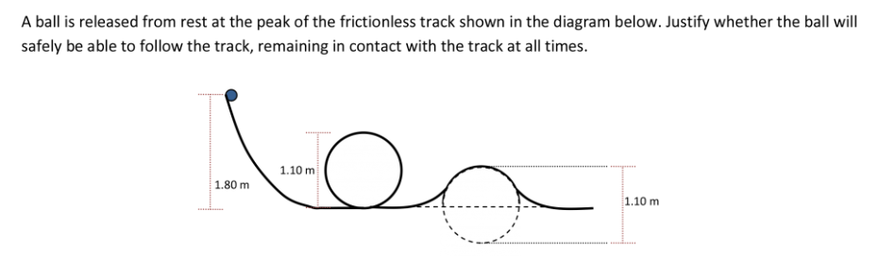
To analyse vertical circular motion
Minimum speed

Slide 18
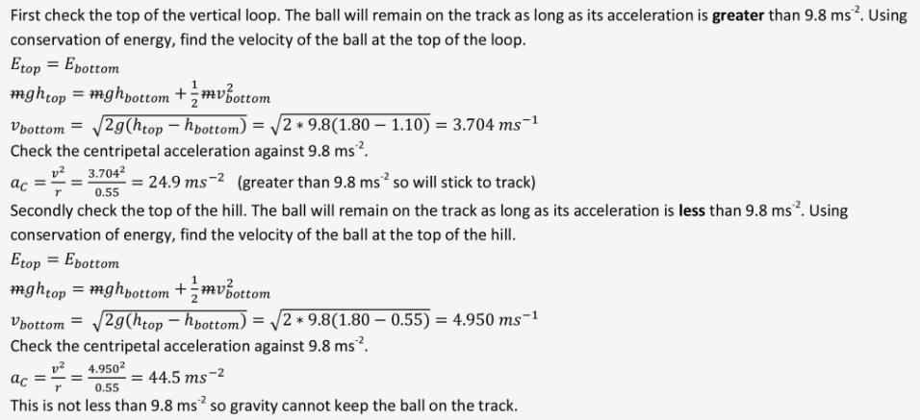
To analyse vertical circular motion
Minimum speed

Slide 19
You can now do Pearson Set 2.6 Review
https://www.youtube.com/watch?v=Zulw5bQ18Kk&ab_channel=FlippingPhysics

Slide 20
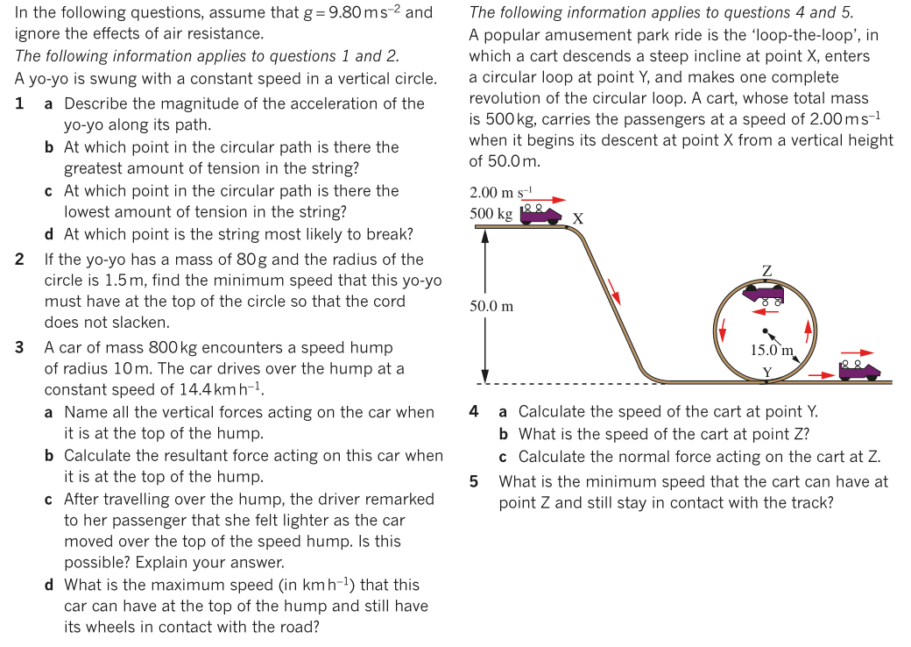

To analyse vertical circular motion
Additional Study

Slide 21
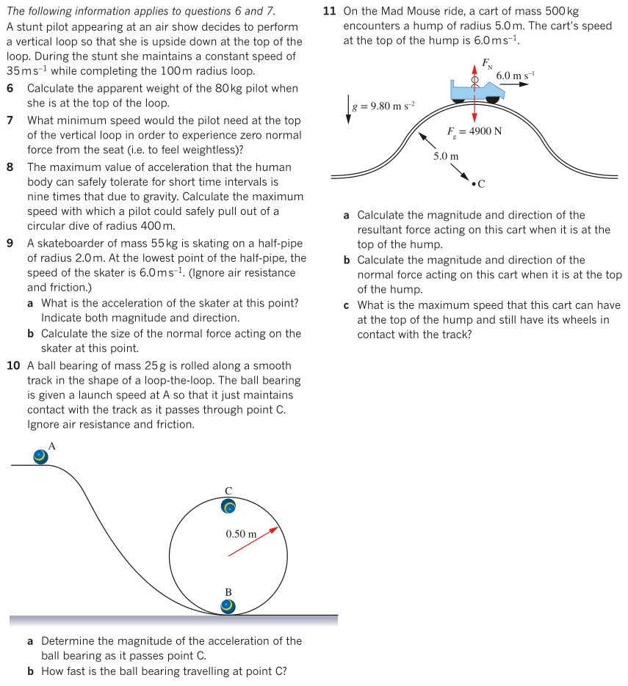
To analyse vertical circular motion
Additional Study

